Slide 1
CASJobs: A Workflow Environment Designed for Large Scientific Catalogs
Nolan Li, Johns Hopkins University

Slide 2
What is CASJobs
  Terabytes of scientific data
Web based system
  Data distribution
  Server-side analysis
  Optimize user work patterns
  Server-side user storage and programmability
Notes:
-briefly go over what CASJobs is and why it might be interesting for those who deal with large sets of scientific data
Web based system designed to host terabytes of scientific data
- focus on efficient distribution of data
- through partial data delivery
- and server-side analysis
The primary goal of CASJobs is to let users bring as much of their work to the data as possible
- if users can do real work on our servers,
- then this reduces the amount of data we need to transfer to them
- this means there’s no need to transfer data they were just going to sift through anyway
- disk is cheaper than bandwidth, especially when we’re talking about terabytes to multiple users
- if we can provide a good way for users to work directly at the data
- then this also expands our potential audience
- anybody with an internet connection could do real research
- instead of just those with the resources to process a terabyte dataset

Slide 3
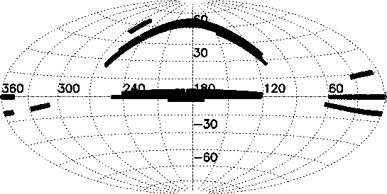
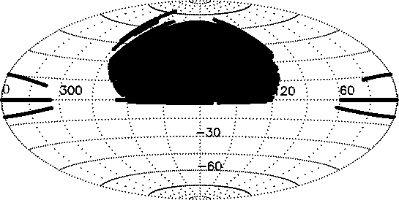
Sloan Digital Sky Survey (SDSS)
Astronomical Survey
  Images (fits) - 15.7 TB
  Other data products ( masks, jpeg images, etc.) (DAS, fits format) - 26.8 TB
  Catalogs (CAS, SQL database) - 18 TB
Data is public
  Delivery?
Notes:
SDSS is the parent project of CASJobs
Astronomy survey
- map over a quarter of the sky
- primarily optical survey
- most data collected with 2.5 meter telescope in new mexico
- images on slide show sky coverage at different stages of the project
Follows a public, monolithic release schedule
- anybody can use get sdss data
- released on a yearly basis
- contains new data
- as well as data from previous releases
data of interest is the Catalog data (on the slide)
- has some low pictures of the sky
- mostly numerical data extracted from images
- object position and magnitude, redshift, etc

Slide 4
Database
Bandwidth is expensive!
10 terabytes is big!
So database it (SkyServer)
  Partial delivery
  Move work to data
Scalability
  Traffic++
  Complexity ++
  Data++
So…
  Cap execution time
  Cap results
  Build something else
Notes:
We serve SDSS data from a database, and let users write their own SQL queries for it
- because SQL is pretty at letting users do work server-side
as an example, say you wanted to find asteroids
- these aren’t explictly flagged in the data so you’d have to sort the asteroids from everything else by looking at positions in time and finding the objects that are moving quickly
- easy in SQL
- so a query will return just asteroid
- this is ‘bringing your work to the data’; the only data transferred was the final result
Our first database interface was called SkyServer
- SkyServer’s query interface was a simple web form that accepted a sql query as input and returned the results as soon as the query completed
- It was succesful, within a year and a half it was running almost as many queries as general web hits, this is shown on the chart
But not scaleable
- over time, queries touched more data and took longer to run
- so we had to cap the query complexity
- and work on a new system that would scale better for large queries

Slide 5
CASJobs
Catalog Archive Server Jobs
  Server-side user storage and programmability
    MyDB
  Hardware abstraction and long-term query portability
    Contexts
  Complete, automatic query logging
  Scalable performance
    Controlled asynchronous query execution
  Data sharing
    Groups
http://casjobs.sdss.org/casjobs
Notes:
we called this new application CASJobs
In a way, SkyServer was sort of an experiment
- SQL interface provided
- but we also provided lots of other tools that didn’t require a user to write SQL
- like a form to find all objects in a given radius at a certain position
We did this because we weren’t sure how astronomers would take to SQL
- cost of entry is relatively high
But the SQL interface of skyserver was succesful; many astronomers were actually writing SQL queries
- and they wanted to run more complex queries than the system could handle
- which is good! They are brining their work to the data, exactly what the database was intended for
Now we just had to make sure they had the tools they need
- so casjobs was written specifically to allow users to use SQL to bring as much work as they can to the server

Slide 6
MyDB
Server-side user database
Intermediate storage
Data import
User programmable
SELECT *
FROM DR4
WHERE a.objid = 38573498
OR a.objid = 92837451
OR a.objid = 20394833
OR a.objid = 90284723
SELECT *
FROM DR4 a, MyDB.MyTable b
WHERE a.objid = b.objid
Notes:
a key feature of casjbos is called MyDB
MyDB is a ‘real’ peronal data we generate for each user
- Unlike a read-only archive database like SDSS, a MyDB is owned by a user, and they can do whatever they want with it
So why do users need their own database on the server?
- simplifies a variety of common work patterns that we’ve seen
- sometimes, research can be a chaotic hit and miss affair
- users may not know exactly what they’re looking for on the first try
- they might have to run lots of queries to eventually get there
- MyDB gives users a place to put the results of these explorative queries; they can be stored as tables in MyDB
- these tables can be integrated into future queries
- can also queries these tables
- sometimes research can be a modular process
- users might use lots of small subsets of data and later assemble them into a complete result set
- with MyDB, users don’t have to do this all in one query
- instead they can write modular queries, store those results in MyDB, then put them all together later
- lastly, sometimes research starts from outside the database
- to accommodate this, users can import external data into a table in MyDB
- then use that table in future queries
- astro example
- find sdss data about a list positions in the sky
- user imports the list of positions then matches them against SDSS data
- example on slide shows how cumbersome this can be without server-side storage
- have to explictly mention each object in the query
- with MyDB you just have to reference the table
In all of these patterns, MyDB is essential to help users break up their work from one query into smaller parts
- Since MyDB is a persistent database, they can pause their research and continue it whenever they want
- MyDB lets all of this work stay server side
So, if SQL help users to bring their work to the data, MyDB helps them keep it there; if they’re proficient with SQL they don’t have to download a thing until they’re satisfied with the result

Slide 7
Logging
Automatically log all user queries
Resubmit old queries
Reconstruct database objects
Notes:
Casjobs automatically logs all queries a user ever runs and keeps them in a history that a user can search
- goes hand in hand with chaotic research patterns
- somebody might be trying to fine-tune a query, constantly running slightly modified versions of it
- they might discover later on that the query they REALLY wanted was the query they had run 5 iterations ago
- with automatic logging, they don’t have to dig through their notes to find that query
- they can just check the history and quickly pull it up

Slide 8
Contexts
Databases are identified by their data, not their location
Queries are independent of hardware configuration
SELECT TOP 10 *
FROM [server].[catalog].[user].MyTable
SELECT TOP 10 *
FROM DR4.MyTable
Notes:
We want queries in CASJobs to last a long time
- users might publish about our data, and we want to make sure that if they publish a query, the results of that query can still be reproduced
- unfortunately, native sql is pretty picky about hardware configuration
- and hardware tends to move around a lot
So in CASJobs, we replaced the part of SQL that is hardware dependent
- objects in casjobs are identified by a unique set of data, rather than the hardware that the data is currently located on
- this abstraction is called a context
Contexts let us move hardware around to wherever we need to without worrying about breaking queries
- so long as the data exists on some machine, user queries will continue to run just fine

Slide 9
Quick Jobs
Executes right away
But not for very long
Restricted memory usage
For things like…
  How many objects ?
  Table previews
  Preliminary queries
  System queries
Notes:
Two different ways to run queries in CASJobs
- the first way is called ‘quick’
- synchronous
- tightly restricted
- in how long they can execute
- and how much data they can return
For queries you know won’t take long and you want the results right away
- querying meta data
- trying to look at a sample of the data

Slide 10
Long Jobs
Asynchronous
Less restricted execution time
Storage capped by MyDB size
For things like…
  Heavy IO
  Heavy computation
Notes:
- Big queries should be run as ‘long’ jobs
- these are asynchrnous
- they are placed in a queue per context and run whenever a slot frees up
- there is an execution time, but it can be days, and is really for catching queries with errors that keep them from halting
- there is no explicit limit on how much data they can return
- results of long jobs are stored directly in MyDB, so a user can store as much data as he has space available
Long jobs provide a controlled environment for big queries; queries that are touching a lot of data and/or doing a lot of computation
- through long jobs we can run the giant queries that SkyServer couldn’t

Slide 11
Groups
Non exclusive sets of CASJobs users
Share data
Keep more work at the data
SELECT *
FROM myGroup.otherUser.theirTable
Notes:
The last feature is called ‘groups’
- lets users share data with other users
- Group functionlity is implemented at the SQL level, the slide shows example of how somebody must query another users table
- there’s also a default group called ‘public’, data shared with this group is available to everybody
Groups are another way we help users keep their work close to the data
- with shared data, they can all work on the same data without having to, say email the file to each other first

Slide 12
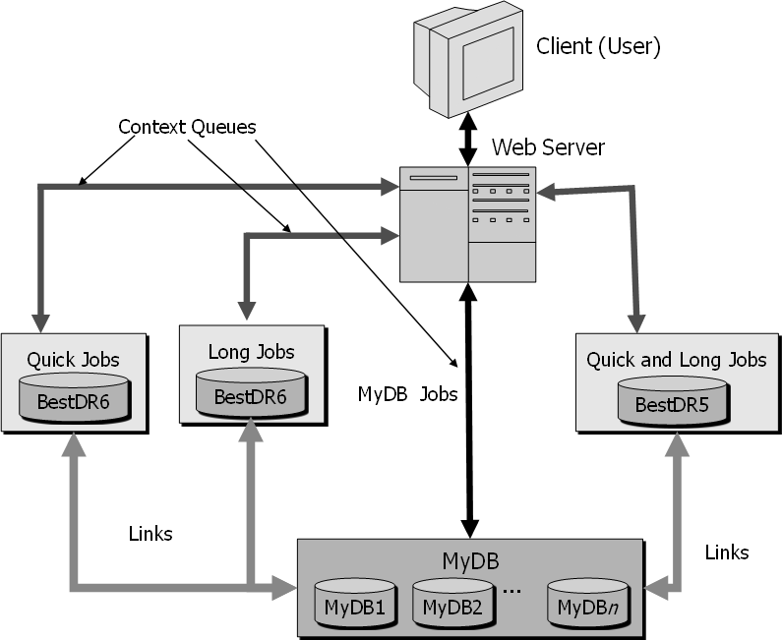
Hardware
Flexible configuration
1+ machine per context (non exclusive)
1+ machine for MyDBs
Notes:
As mentioned on the context slide
- hardware tends to move around
- casjobs is designed to be flexible about this; hardware can move around without affecting user queries
Context databases and MyDB may all be hosted on either one or multiple machines
- also, you can optionally have quick jobs go to one machine and long jobs to another
As an example
- usually we have the latest data release hosted on two machines, one for quick jobs, one for long
- this is the context that is heaviest hit, and needs the most resources
- whenever a new release comes out
- can modify quick and long to go to the lame machine

Slide 13
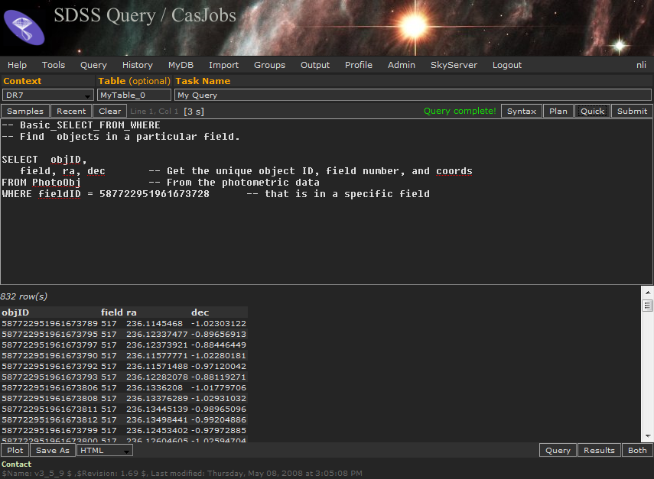
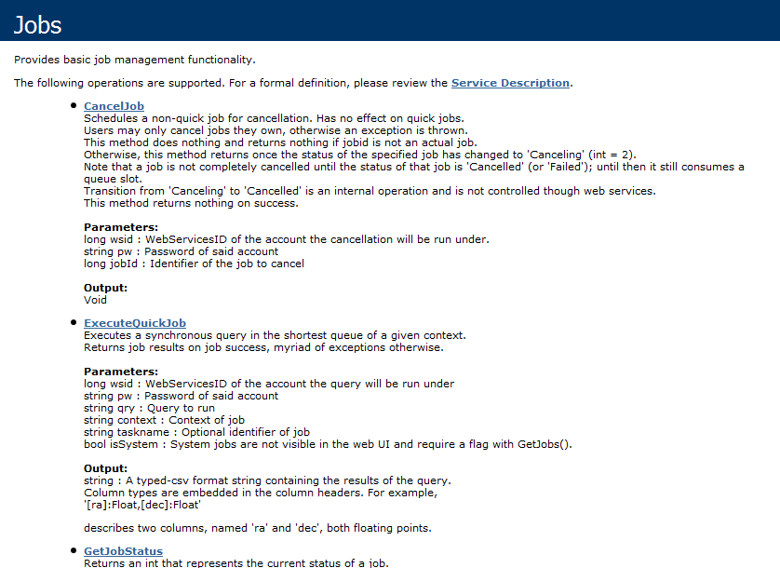
Interface
Web Site
Web Services
Notes:
-One can access CASJobs through the web interface, or programmatically through web services.
- All functionality mentioned in this talk can be fully utilizaed through web services
- they let 3rd parties easily write custom clients
- existing clients include
- including an emacs client, written in elisp, that can submit both quick and long jobs
- and also furthers the cause of emacs as a great operating system
- also a command line java client that does much the same thing

Slide 14
Usage
> two million jobs
> 2200 users
Astro deployments
  Galaxy Evolution Explorer (GALEX)
  Palomar Quest
  Panoramic Survey Telescope and Rapid Response System (Pan-STARRS)[3].
Non Astro deployments
  Ameriflux
  Swiss Institute of Bioinformatics (ISB)
Notes:
Casjobs orginally released in 2003
- the original deployment is hosted at fermilab in illinois
- and has run over two million queries
- from over 2200 registered users
Original deployment, because there are currently multiple casjobs floating around
- most deployments are hosting astronomy data, slide lists a few
- but there are also non astronomy deployments
- ameriflux is a enviromental science survey focussing on carbon emissions
- and the Swiss Institute of Bioinformatics is planning on using CASJobs to host proteomics data
Questions?

