Slide 1
A History-tracing XML-based Provenance Framework for Workflows
Michael Gerhards*, Adam Belloum**, Frank Berretz*, Volker Sander*, Sascha Skorupa*
11/14/2010
* FH Aachen - University of Applied Sciences (Germany) ** University of Amsterdam (Netherlands)

Slide 2

Workflows in eGovernment
Example of
Supply Note 2
Waste type
Amount
...
Originator Signature
Receive Date
Destination
...
Carrier Signature
Receive Date
...
Contractor Signature
Government Signature
government agency
(originator)
government agency
(contractor)
2
2
3
for the log of the originator
originator
5
waste disposal contractor
2
3
1
garbage acceptance
4
5
6
supply note
4
1
2
3
carrier
4
5
6
14. November 2010 - 2
14. November 2010 - 2
Notes:
2

Slide 3


Sequential Structures
Document
Workflow
Document
Actors
Actors
Layer A
Data …
Layer A
Data …
Task A
Layer B
Data …
Layer B
Data …
Task B
Notes:
Problem: Inclusion of Task B destroys Signature of A
Problem: The history (Task A) is not signed by B

Slide 4
Hierarchical Structure
Document
Workflow
Actors
Layer B
Data …
Layer A
Data …
Task A
Task B
Notes:
If an actor signs his contribution, he also signs the whole history of all things which happens before

Slide 5
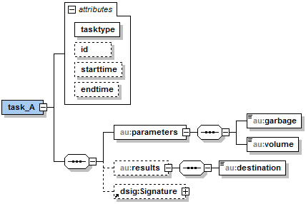
Mapping to XML
<root>
<task_B ...>
<task_A tasktype=“SEQ”
id=“task_A_1“
starttime=“2010-11-08T16:20...”
endtime=“2010-11-08T16:21...”>
<parameters>
<garbage>
oil
</garbage>
<volume>
100 L
</volume>
</parameters>
<results>
<destination>
John Doe Company
</destination>
</results>
<Signature>...</Signature>
</task_A>
<parameters>...</parameters>
<Signature>...</Signature>
</task_B>
</root>
Task A
Task B
Notes:
Qualified electronic XML-Signatures: XAdES XML-DSig
Includes enveloped XML signature over(?) own and previous layers
Recursively nested layers. Youngest layer contains older ones

Slide 6
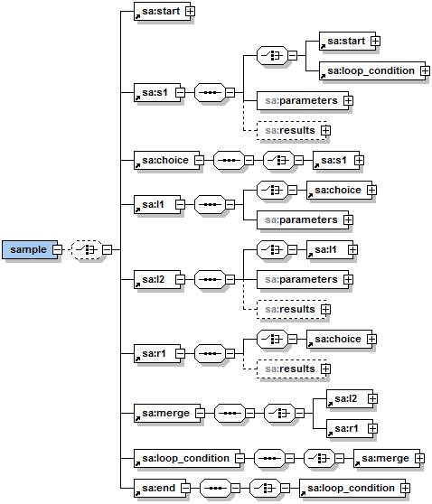
Layer Structure for Control Flow Patterns
s1
Sequence
X
l1
r1
l2
M
X
Notes:
Global element for each task: Enables further processing / Validation of run

Slide 7
Layer Structure for Control Flow Pattern
s1
Exclusive Choice
X
l1
Sequence
r1
l2
Sequence
M
X

Slide 8
Layer Structure for Control Flow Pattern
s1
X
l1
r1
l2
M
Merge
X

Slide 9
Layer Structure for Control Flow Pattern
s1
X
l1
r1
l2
M
X
Arbitrary Cycle

Slide 10
Parallel Split and Synchronization
<task2><params>…</params><results>…</results>
<synchronization>
<branch_L>
<task_L2><params>…</params><results>…</results>
<task_L1><params>…</params><results>…</results>
<Container><Signature>Task1</Signature></Container>
<Signature>L1</Signature>
</task_L1>
<Signature>L2</Signature>
</task_L2>
</branch_L>
<branch_R>
<task_R1><params>…</params><results>…</results>
<Container><Signature>Task1</Signature></Container>
<Signature>R1</Signature>
</task_R1>
</branch_R>
<parallel_split>
<task1><params>…</params><results>…</results>
<Signature>Task1</Signature>
</task1>
</parallel_split>
</synchronization>
<Signature>Task2</Signature>
</task2>
task1
+
L1
R1
L2
-
task2
Notes:
No Happened Before relation -> Unknown Order
Solution:
Split up the layer chain and start new chain
Copy newest signatures to all branches
Synchronizing layer encloses all parallel layers
Enables parallel sections inside and after each other

Slide 11
Provenance Framework

Slide 12
Independent Libraries
workflow template
create
create
WfMS I
workflow
instance
workflow
instance
schema library
document library
instance
instance
instance
create
update
provenance schema
WF-TID = 1.xsd
instance of
provenance
I-ID = a.xml
provenance
I-ID = b.xml
Notes:
Until now: Specifications exists but don’t want to use xml editor to create files
Library to create documents of theses types is needed, hide XML structure
(both independent of WfMS) advantage and disadvantage
Link between WfMS and Framework

Slide 13
Communication
workflow template
create
create
WfMS I
workflow
instance
workflow
instance
Missing function
calls
Unknown template
processing language
Different programming languages
schema library
document library
instance
instance
instance
create
update
provenance schema
WF-TID = 1.xsd
instance of
provenance
I-ID = a.xml
provenance
I-ID = b.xml
Notes:
Abstract workflow to create schema
Data of workflow instance to create and update provenance file

Slide 14
Template Registration
workflow template
WfMS I
input file
WFT-ID = 1
template endpoint
template analyzer for WfMS III
Web Server
template analyzer for WfMS II
template analyzer for WfMS I
schema library
document library
instance
create
provenance schema
WFT-ID = 1.xsd

Slide 15
Instance Registration
workflow template
create
create
WfMS I
workflow
instance
workflow
instance
WFT-ID = 1
WFT-ID = 1
I-ID = a
I-ID = b
template endpoint
instance endpoint
template analyzer for WfMS III
Web Server
WFT-ID = 1
WFT-ID = 1
template analyzer for WfMS II
template analyzer for WfMS I
schema library
document library
instance
instance
provenance schema
WFT-ID = 1.xsd
Load WFT-ID = 1

Slide 16
Instance Data Transmission
workflow template
create
create
WfMS I
workflow
instance
workflow
instance
data
I-ID = a
I-ID = b
template endpoint
instance endpoint
template analyzer for WfMS III
Web Server
data
of a
data
of b
template analyzer for WfMS II
template analyzer for WfMS I
schema library
document library
instance
instance
update
provenance schema
WFT-ID = 1.xsd
instance of
provenance
I-ID = a.xml
provenance
I-ID = b.xml

Slide 17
Conclusion
Provenance Framework that enables history tracing for digital signatures
High liability through special layer model which allows signing of signatures and history
Should only be used for small actor-driven workflow approaches
Simplifies debugging and searching for optimization during runtime
Schema for each workflow enables easy further processing
Notes:
High availability through trusted Web service environment
SOAP calls with https

Slide 18
Outlook
Improve usability:
Support of Error-Handling and Feedback of the Webserver
Support of further control-flow patterns and asynchronous calls
Improve Performance:
Split large documents for a better performance
Integration of documents inside a database
Improve Access:
Grid Integration in UNICORE middleware platform
Support File-Layer-Access through special Browser
Integration of Role-based Authorization framework of the HiX4AGWS project
Notes:
fine granular access only to certain layers

Slide 19
FH Aachen University of Applied Sciences
Campus Jülich
Germany
Heinrich-Mußmannstraße 1
52428 Jülich m.gerhards@fh-aachen.de, a.s.z.belloum@uva.nl, berretz@fh-aachen.de, v.sander@fh-aachen.de, skorupa@fh-aachen.de http://www.fh-aachen.de/hixforagws.html

