Slide 1


Network resource selection for data transfer processes in scientific workflows
Zhiming Zhao
Paola Grosso, Ralph Koning, Jeroen van der Ham, Cees de Laat
System and Network Engineering (SNE)
University of Amsterdam (UvA)
Z.Zhao et al., Network resource selection for data transfer processes in scientific workflow s, WORKS10, New Orleans, 2010.

Slide 2
Outline
Background: e-Science, Scientific workflows and advanced network infrastructure
Research problem: including network QoS in scientific workflows
NEWQoSPlanner: an agent based solution
A use case: “Quality guaranteed video delivery on demand”
Discussion
Conclusions and future work

Slide 3
Background: e-Science and scientific workflow
E-Science applications are characterized by
  Massive data (acquiring and storing)
  Intensive computing (Simulation, visualization and data processing)
  Large scale collaboration (among processes, resources and domain scientists)
  …
A workflow management system
  Automates the execution of experiment processes
  Controls the flow (data and control ) between processes
  Allows scientists focus on experiments at different levels of abstractions
  Hides the low level technical details from scientists
  …
  Has been recognized as a core e-Science service.
Notes:
3

Slide 4

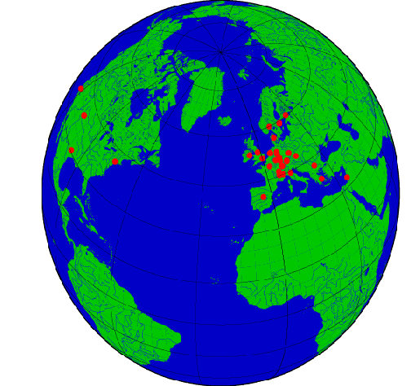




Workflow execution: mapping between resources
Data acquisition
Visualization
Abstract processes
Storing results
Processing
Concrete
workflow
Storage, computing elements
Network

Slide 5
Quality tuning in scientific workflow
Data acquisition
Visualization
In traditional loop
Abstract processes:
Refine application logic
Storing results
Processing
Concrete
workflow: select optimal services, components
Storage, computing elements: select high performance resources
New loop
Network: network path selection.

Slide 6
Why including advanced network in the loop?
Data movement causes performance bottleneck for workflow,
  Scientific workflows are often data intensive;
  and quality control at high level is not sufficient;
Existing workflow systems did not take network service into account
  Existing network infrastructure provides limited flexibility for application level control.
Advanced network , e.g., multi layer and programmable network, offer high level application new opportunities:
  Path selection;
  Provisioning;
  Allocation.

Slide 7
Related work: QoS in the workflow lifecycle
QoS in workflow description
  QoS texonomy [Sabata, 97], QoS ontology [Gramm, 03], QML [Frolund, 98], Vienna composition language (VCL) [Rosenberg, 09].
Resource broker
  budget based scheduling, Nimroad-G, GRACE [Buyya, 02].
  Constraints between quality parameters (such as execution time, reliability etc.) and economic cost.
Service selection
  Composition: requirement specification [Jia 05], service selection [Zeng 04], [Brandic 05].
  Enactment and scheduling [Yash, 06], planning, and resource reservation [Benkner, 04].
Network control in workflow
  VLAM and interactive network [Belloum et. al, 09]
QoS constraint solving
  Shortest path finding algorithm;
  Multi objective optimization problem: Ant colony optimization (ACO).

Slide 8
What did we observe?
Most of workflow systems do not include network quality parameters in the workflow scheduling and execution control.
The work in VLAM and interactive network integrates the workflow engine with special network using a customized solution, which does not promote the reusability of the solution.
We need a new solution!

Slide 9
Research context and approach
CineGrid project
  Main mission: dedicated network, share large quantities of very high quality media material.
What has been developed:
  Semantic description of the resources
    Network description language (NDL);
    CineGrid description language (CDL).
Approach
  Propose an independent service, which can be plugged in existing workflow system to provide network QoS features

Slide 10
Network for Workflow QoS planner (NEWQoSPlanner)
A planner for optimizing data movement related workflow processes
  Select network resources
  Make provisioning plans
  Generate network QoS aware sub workflow
Data acquisition
Visualization
Storing results
Processing
?
NEWQoSPlanner

Slide 11
NEtwork awareWorkflow QoS Planner
(NEWQoSPlanner)
Network resource descriptions
Resource Discovery
Agent (RDA)
Multi agent system for QoS aware workflow management
Workflow
Composer
Agent (WCA)
requirements
Resource candidates
Selected candidate
Media delivery workflow
User
request
QoS aware Workflow Planner (QoSWP)
Selected candidate
Resource Provision
Planner (RPP)
Provisioning plan
Provision
plan
Data
delivery
workflow
QoS Monitoring Agent (QMA)
Provenance Service Agent (PSA)
Workflow engine
Resources

Slide 12
NEtwork awareWorkflow QoS Planner
(NEWQoSPlanner)
Network resource descriptions
Resource Discovery
Agent (RDA)
Multi agent system for QoS aware workflow management
Workflow
Composer
Agent (WCA)
requirements
Resource candidates
Selected candidate
Media delivery workflow
User
request
1
QoS aware Workflow Planner (QoSWP)
Selected candidate
Resource Provision
Planner (RPP)
Provisioning plan
Provision
plan
Data
delivery
workflow
QoS Monitoring Agent (QMA)
Provenance Service Agent (PSA)
Workflow engine
Resources

Slide 13
NEtwork awareWorkflow QoS Planner
(NEWQoSPlanner)
Network resource descriptions
Resource Discovery
Agent (RDA)
Multi agent system for QoS aware workflow management
Workflow
Composer
Agent (WCA)
requirements
Resource candidates
Selected candidate
Media delivery workflow
2
User
request
1
QoS aware Workflow Planner (QoSWP)
Selected candidate
Resource Provision
Planner (RPP)
Provisioning plan
Provision
plan
Data
delivery
workflow
QoS Monitoring Agent (QMA)
Provenance Service Agent (PSA)
Workflow engine
Resources

Slide 14
NEtwork awareWorkflow QoS Planner
(NEWQoSPlanner)
Network resource descriptions
Resource Discovery
Agent (RDA)
Multi agent system for QoS aware workflow management
Workflow
Composer
Agent (WCA)
requirements
3
Resource candidates
Selected candidate
Media delivery workflow
2
User
request
1
QoS aware Workflow Planner (QoSWP)
Selected candidate
Resource Provision
Planner (RPP)
Provisioning plan
Provision
plan
Data
delivery
workflow
QoS Monitoring Agent (QMA)
Provenance Service Agent (PSA)
Workflow engine
Resources

Slide 15
NEtwork awareWorkflow QoS Planner
(NEWQoSPlanner)
Network resource descriptions
Resource Discovery
Agent (RDA)
Multi agent system for QoS aware workflow management
Workflow
Composer
Agent (WCA)
requirements
3
Resource candidates
Selected candidate
Media delivery workflow
2
4
User
request
1
QoS aware Workflow Planner (QoSWP)
Selected candidate
Resource Provision
Planner (RPP)
4
Provisioning plan
Provision
plan
Data
delivery
workflow
QoS Monitoring Agent (QMA)
Provenance Service Agent (PSA)
Workflow engine
Resources

Slide 16
NEtwork awareWorkflow QoS Planner
(NEWQoSPlanner)
Network resource descriptions
Resource Discovery
Agent (RDA)
Multi agent system for QoS aware workflow management
Workflow
Composer
Agent (WCA)
requirements
3
Resource candidates
5
Selected candidate
Media delivery workflow
2
4
User
request
1
QoS aware Workflow Planner (QoSWP)
Selected candidate
Resource Provision
Planner (RPP)
4
Provisioning plan
5
Provision
plan
Data
delivery
workflow
QoS Monitoring Agent (QMA)
Provenance Service Agent (PSA)
Workflow engine
Resources

Slide 17
NEtwork awareWorkflow QoS Planner
(NEWQoSPlanner)
Network resource descriptions
Resource Discovery
Agent (RDA)
Multi agent system for QoS aware workflow management
Workflow
Composer
Agent (WCA)
requirements
3
Resource candidates
5
Selected candidate
Media delivery workflow
2
4
User
request
1
QoS aware Workflow Planner (QoSWP)
Selected candidate
Resource Provision
Planner (RPP)
4
Provisioning plan
5
6
Provision
plan
Data
delivery
workflow
QoS Monitoring Agent (QMA)
Provenance Service Agent (PSA)
Workflow engine
Resources

Slide 18
NEtwork awareWorkflow QoS Planner
(NEWQoSPlanner)
Network resource descriptions
Resource Discovery
Agent (RDA)
Multi agent system for QoS aware workflow management
Workflow
Composer
Agent (WCA)
requirements
3
Resource candidates
5
Selected candidate
Media delivery workflow
2
4
User
request
1
QoS aware Workflow Planner (QoSWP)
Selected candidate
Resource Provision
Planner (RPP)
4
Provisioning plan
5
6
7
7
Provision
plan
Data
delivery
workflow
QoS Monitoring Agent (QMA)
Provenance Service Agent (PSA)
Workflow engine
Resources

Slide 19
Implementation issues
QoS requirements
Resource selection
Workflow composition
Resource monitoring
Adaptable network resource planning

Slide 20
Implementation issues
QoS requirements
Resource selection
Workflow composition
Resource monitoring
Adaptable network resource planning

Slide 21
Network and Cine Grid description language
CineGrid resource Description Language
  Content: video/audio/data
  Services: storage, visualization, streaming etc.
  Devices: host, screen, projector, etc.
Network Description Language
  Interface
  Devices
  Connection points
Ontologies are integrated via property
  owl:equivalentClass
  owl:equivalentProperty
  owl:sameAs

Slide 22
QoS abstract workflow process description schema
Data related process
Pre/Execution/Post condition
QoS (attributes)

Slide 23
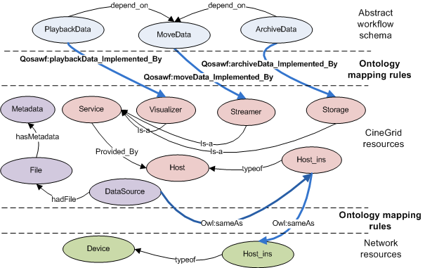
Ontology mapping

Slide 24
Resource selection
From resource description and requirements to derive set of candidates (data sources, destinations and network paths)
Data sources are derived from the pre conditions of the process
Data destinations are derived from the process and post condition
Network paths: paths between source and destination
Ranking: order the candidates based on the quality

Slide 25
Searching procedure

Slide 26
Current prototype
SWIProlog/Semantic web library
  RDF triples manipulations
  Graph finding algorihm -> network path
  Solving constraints
JAVA Prolog interface (JPL)
  Manipulate Prolog functions via Java
Java Agent development framework
  Agent communication language (ACL) between agents
  XMLRPC: between agent and web portal

Slide 27
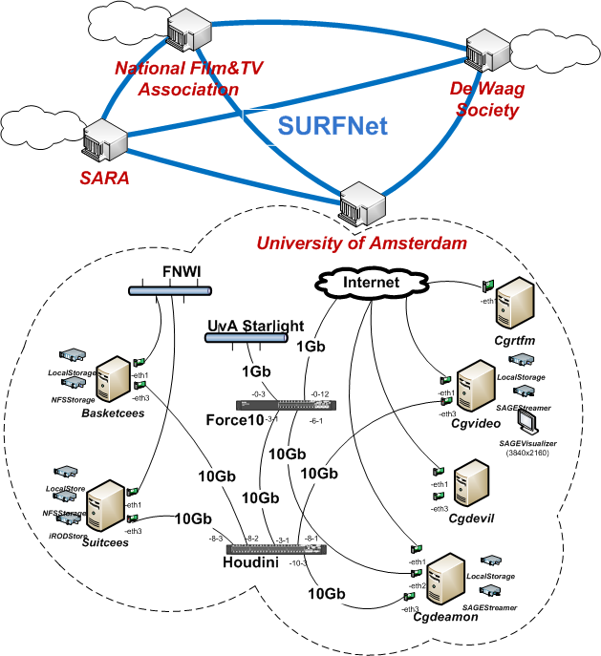
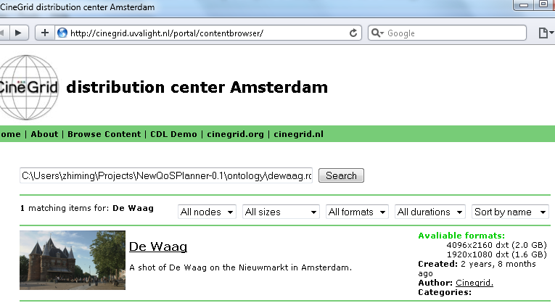
Use case: QoS guaranteed media delivery on demand
Media delivery on demand
  Search movie
  Propose network path
  Playback the movie
Portal + search engine (RDA)

Slide 28
Query time and triples
The above figure shows the time costs for a query while the number of triples loaded in the search engine increases. It is measured while all previous queries are kept in the memory. The result implies the cost while concurrent queries are made. In the actual situation, the server cleans the history of a query after it expired. A query usually contains 20 ~30 triples.

Slide 29
Query time cost
The figure shows the time costs for some typical queries. The cost of a query depends on the number of constraints, and the quantity of available meta information of the resource.

Slide 30
Discussion
The QoSAWF can describe most of the cases we need in the use case.
Quality evaluation of the candidate
  How precise the descriptions are?
  The monitoring of the actual state of the network
Static analysis

Slide 31
Conclusions
Network quality tuning is crucial for improving performance of data movement processes in scientific workflows;
Using the semantic web technology, the QoSAWF ontology provides a lightweight solution to describing QoS requirements for data operation related workflow process;
The network resource discovery agent provides necessary service for tuning data transfer processes from the application level.

Slide 32
Future work
Semantic search of movie data
From single process searching to multiple processes
Automatic composition of provisioning plan and workflow

Slide 33
References
QoSAWF: http://cinegrid.uvalight.nl/owl/qosawf.owl
CDL: http://cinegrid.uvalight.nl/owl/cdl/2.0
NDL domain: http://cinegrid.uvalight.nl/owl/ndl-domain.owl
NDL topology: http://cinegrid.uvalight.nl/owl/ndl-topology.owl
Portal: http://cinegrid.uvalight.nl/
Booth at SC10: Dutch research, #4049

